Slide 1
EE 473 Music Genre Classification with DSP and Deep Learning
One of the current problems about audio is how is should be represented.
It could be a .wav file, containing the pure signal.
The pure signal isn't very handy though - mainly because it's quite heavy.
30 s sound with 22050 sampling rate = 661.500 data points
The rhythmic patterns of musics can be utilized to describe and differentiate audio signals as elaborated features in order to identify the various genres.
Idea : a spectogram of a music can be utilized as descriptor
Approach: Extract features with STFT, feed them to a deep neural network

Slide 2
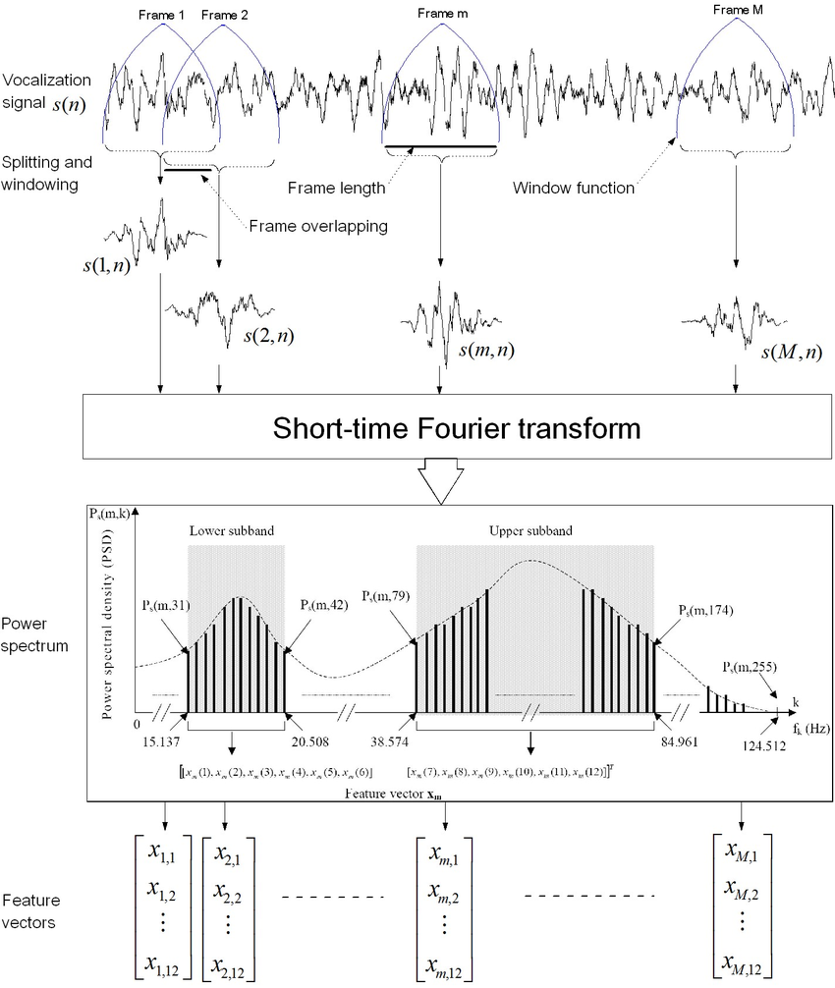
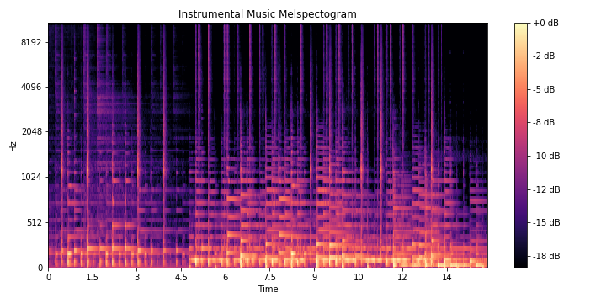
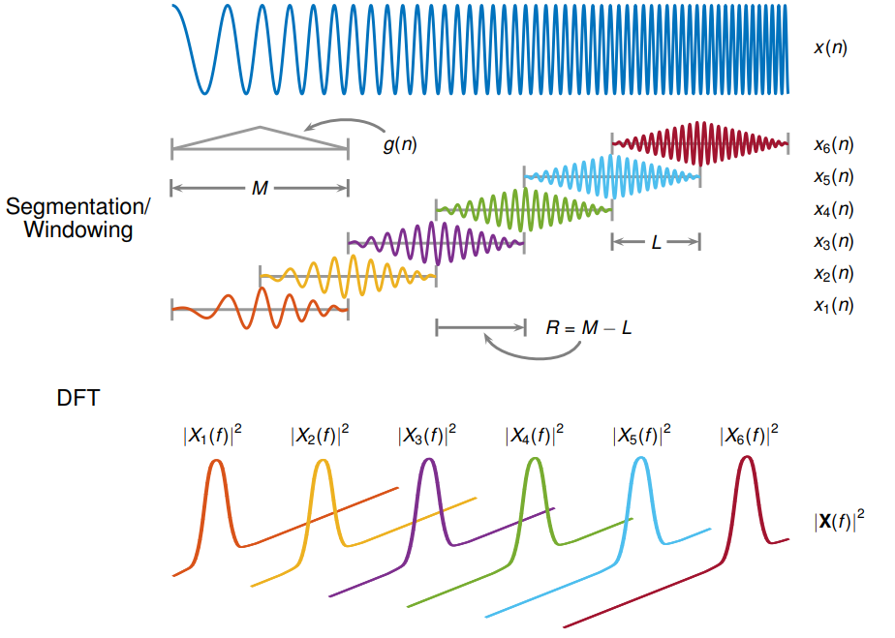
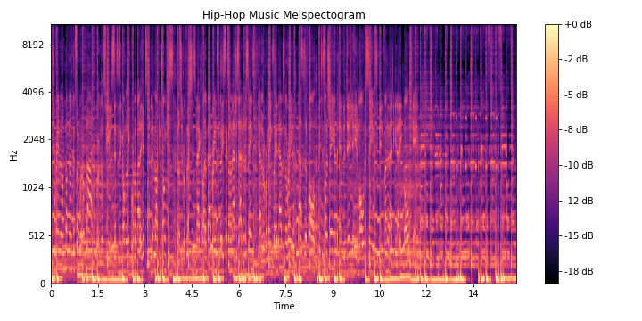
2. Methodology
Short-time Fourier Transform
Mel-Spectogram

Slide 3
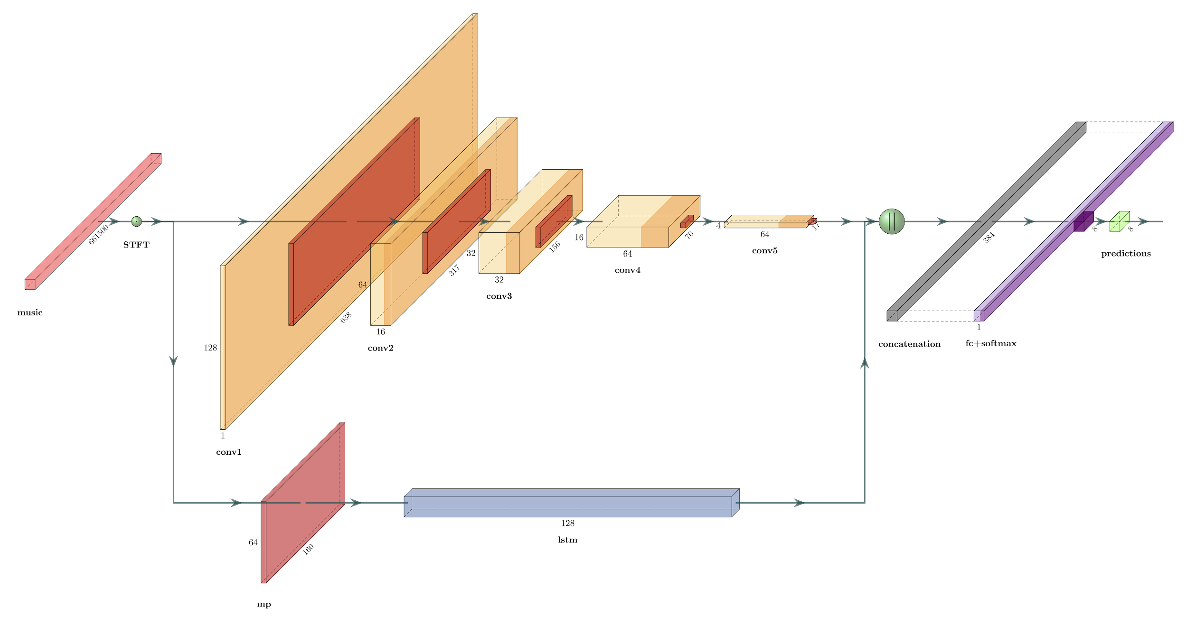

Slide 4
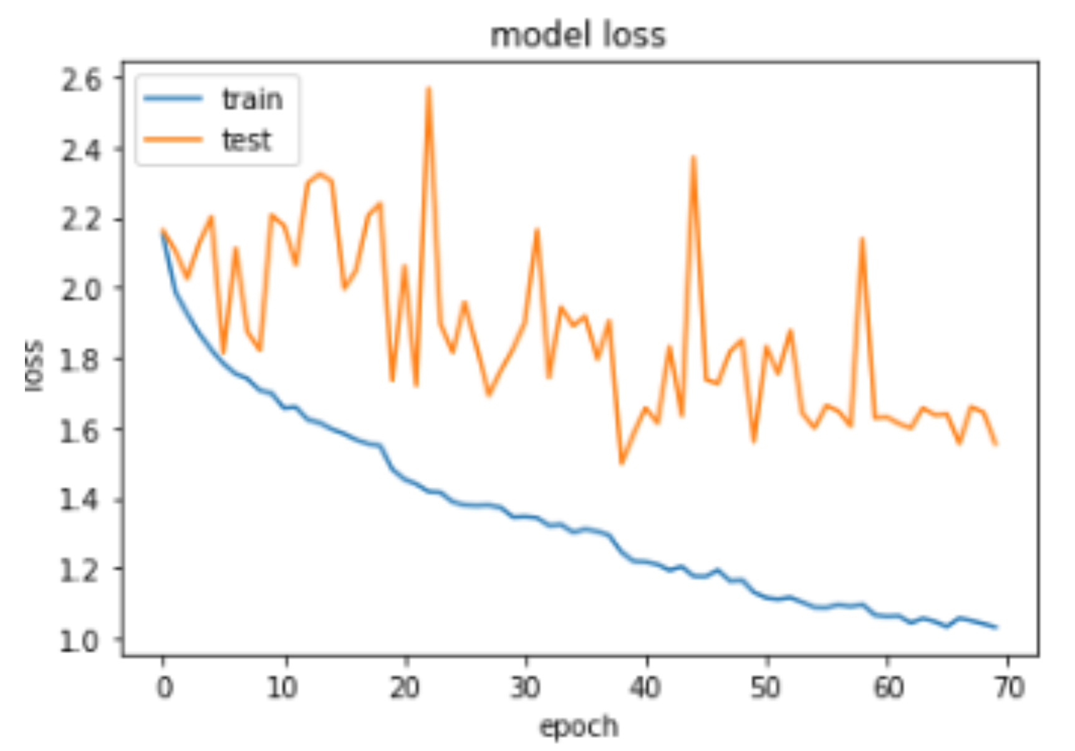
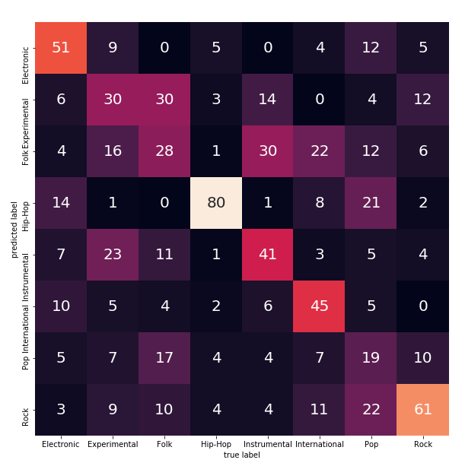
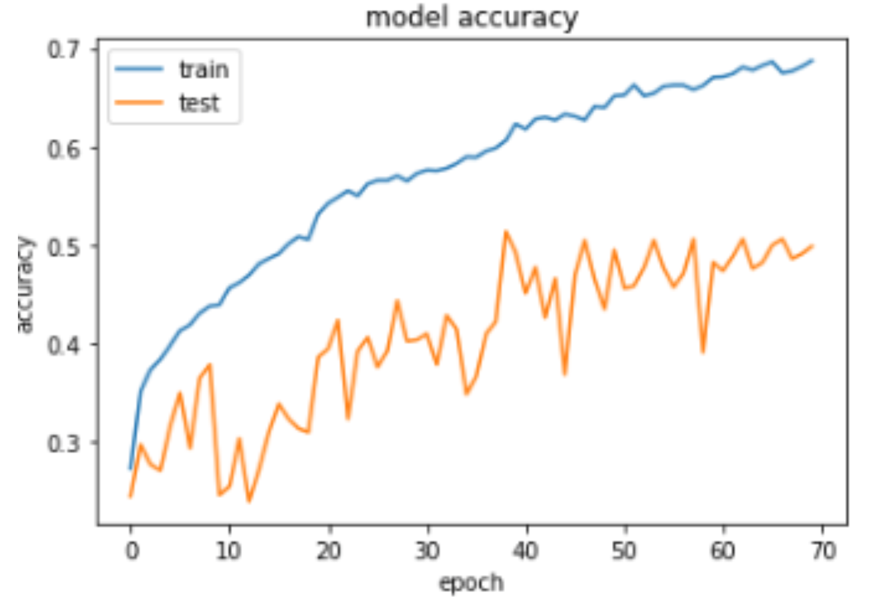
3. Results

Slide 5
4. Conclusion
We were able to train a small architecture using Mel-Spectograms of sound to classify genres.
~60-70% accuracy is achieved.
However, spectograms for the same genre might not be a good descriptors for composer classification.
One can find better STFT parameters that leads better classification performance by hyper-parameter optimization (i.e. grid search).
With more data and/or using more deep network with different loss function might yield better results.

